Slide 1

Go, change the world
RV College of
Engineering
UNIT 5:
From Serial to Parallel Programming using
OpenACC
By:
Name
USN
High Performance Computing Architecture

Slide 2

Introduction
Go, change the world
RV College of
Engineering
What is OpenACC?
OpenACC (Open Accelerators) is a parallel programming model
It is designed to simplify the process of writing parallel code for:
Heterogeneous computing systems *
System that uses multiple types of computing cores,
CPUs (Central Processing Units) GPUs (Graphics Processing Units) FPGAs (Field-Programmable Gate Arrays) ASICs (Application-Specific Integrated Circuits) Other specialized accelerators (Eg: Google's TPU, Apple’s NPU)

Slide 3
Features
Go, change the world
RV College of
Engineering
“It enables developers to harness the power of accelerators (GPU, FPGA,...) without needing to manage the low-level details of hardware.”
Directive-based:
OpenACC uses compiler directives (similar to OpenMP) to specify parallel regions in the code.
Offloading:
The primary focus of OpenACC is to offload computation to accelerators, such as GPUs.
Portability:
OpenACC is designed to be portable across different platforms (CPUs, GPUs, etc.) without needing significant changes to the code for different architectures.
User-Friendly:
It abstracts the complexity of parallelizing code, especially for GPU and accelerator programming, which can be difficult with low-level languages like CUDA.

Slide 4
Similarity
Go, change the world
RV College of
Engineering
“It enables developers to harness the power of accelerators (GPU, FPGA,...) without needing to manage the low-level details of hardware.”
OpenACC | OpenMP | CUDA | OpenCL
Open Accelerator | Open Multi-Processing | Compute Unified Device Arch | Open Computing Language
High Level abstraction (directives) |  | Low Level (GPU control and kernel program)
Offloading to Accelerators | Shared-Memory Parallelism | GPU Programming | Heterogeneous Parallelism
GPU, FPGA,… | Multi-core CPU

Slide 5

HISTORY
Go, change the world
RV College of
Engineering
The Portland Group Inc. is a research company that has produced C, C++, Fortran COMPILERS for HPC systems
2012
OpenACC standard directives for GPU computing was developed
Available under
“PGI Compilers and Tools”
2014 – Nvidia acquires PGI. The PGI staff continued their operation independently
2020
Nvidia integrates PGI technology into “NVIDIA HPC SDK” product
Available under
NVIDIA HPC SDK

Slide 6

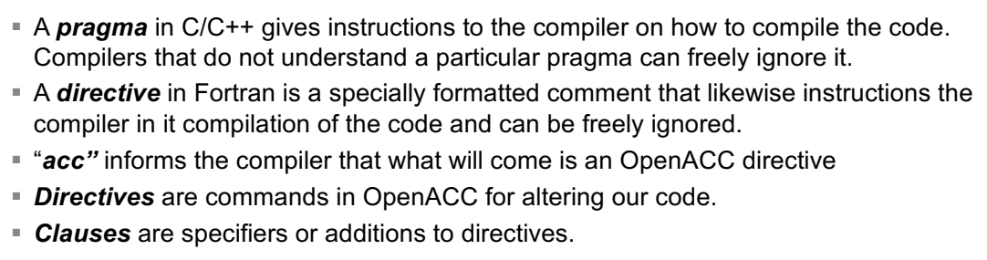
USAGE
Go, change the world
RV College of
Engineering
To analyze the distribution of funding amounts among the startups

Slide 7
DEMO
Go, change the world
RV College of
Engineering

Slide 8
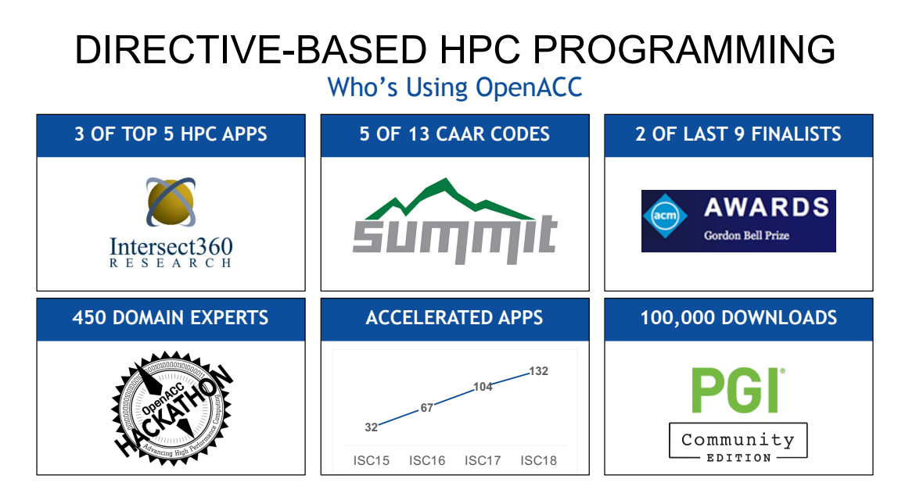
USECASE
Go, change the world
RV College of
Engineering

Slide 9
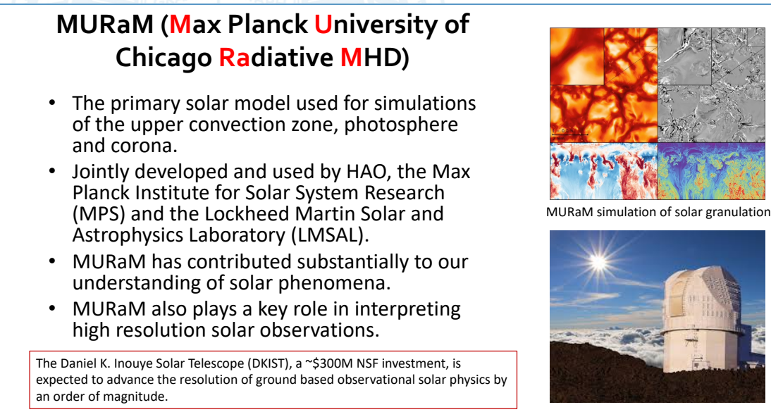
USE CASE
Go, change the world
RV College of
Engineering

Slide 10
Thank You
Go, change the world
RV College of
Engineering

